Slide 1
0x406 – Finding Binaries
ECED4406 – Computer Security
Dr. Colin O’Flynn
Dalhousie University.

Slide 2
NOTE: This material is now covered in slides ~0x300 series mostly. I’ve left these slides up for posterity, but there isn’t new information.

Slide 3
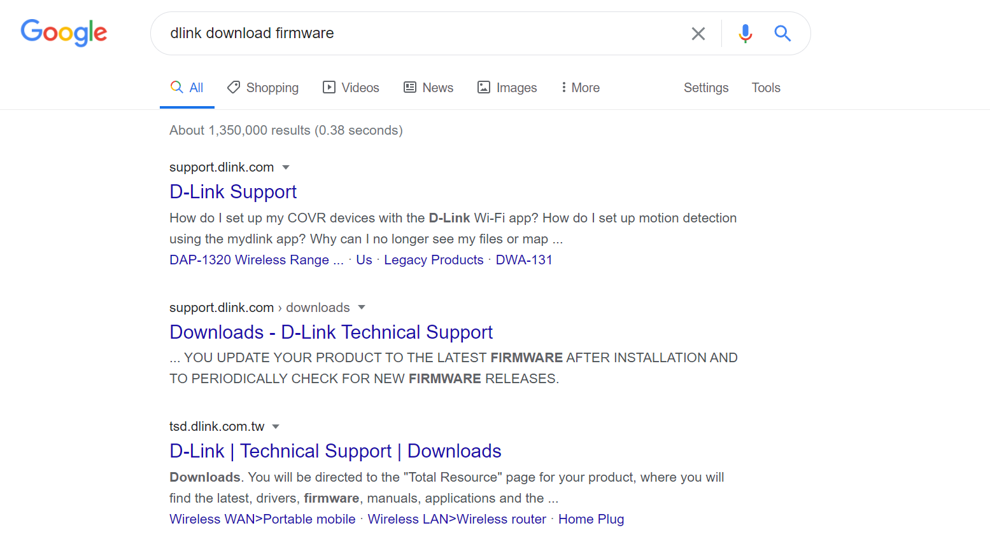
Finding Binaries
Binary is the firmware running on a device.

Slide 4
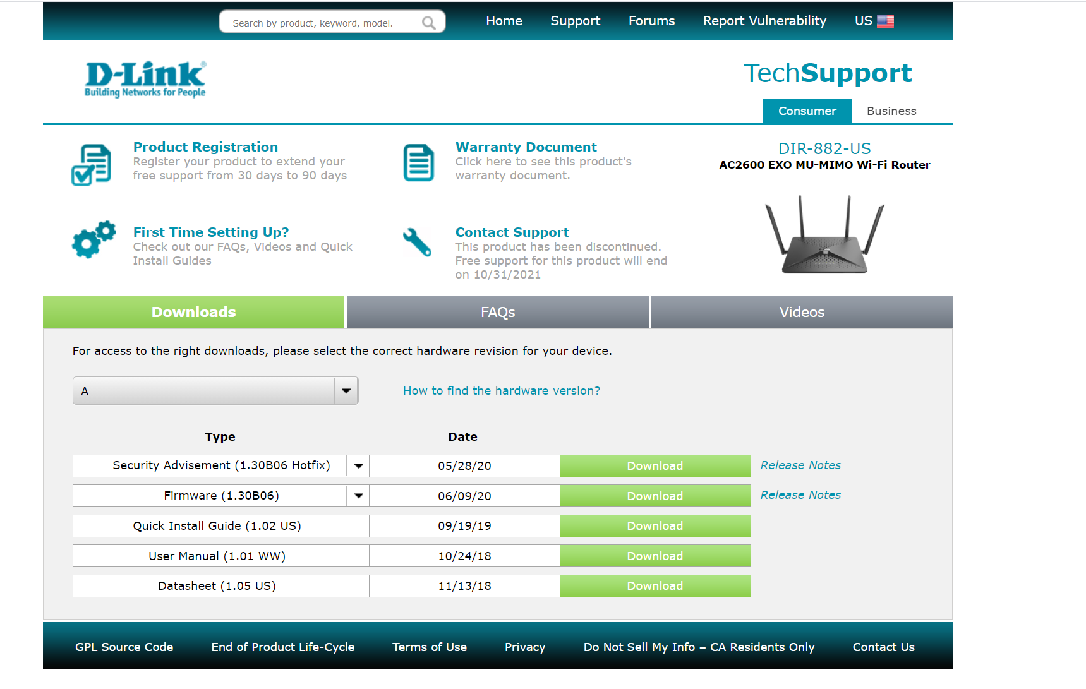
Example – Dlink Router
https://support.dlink.com/ProductInfo.aspx?m=DIR-882-US

Slide 5
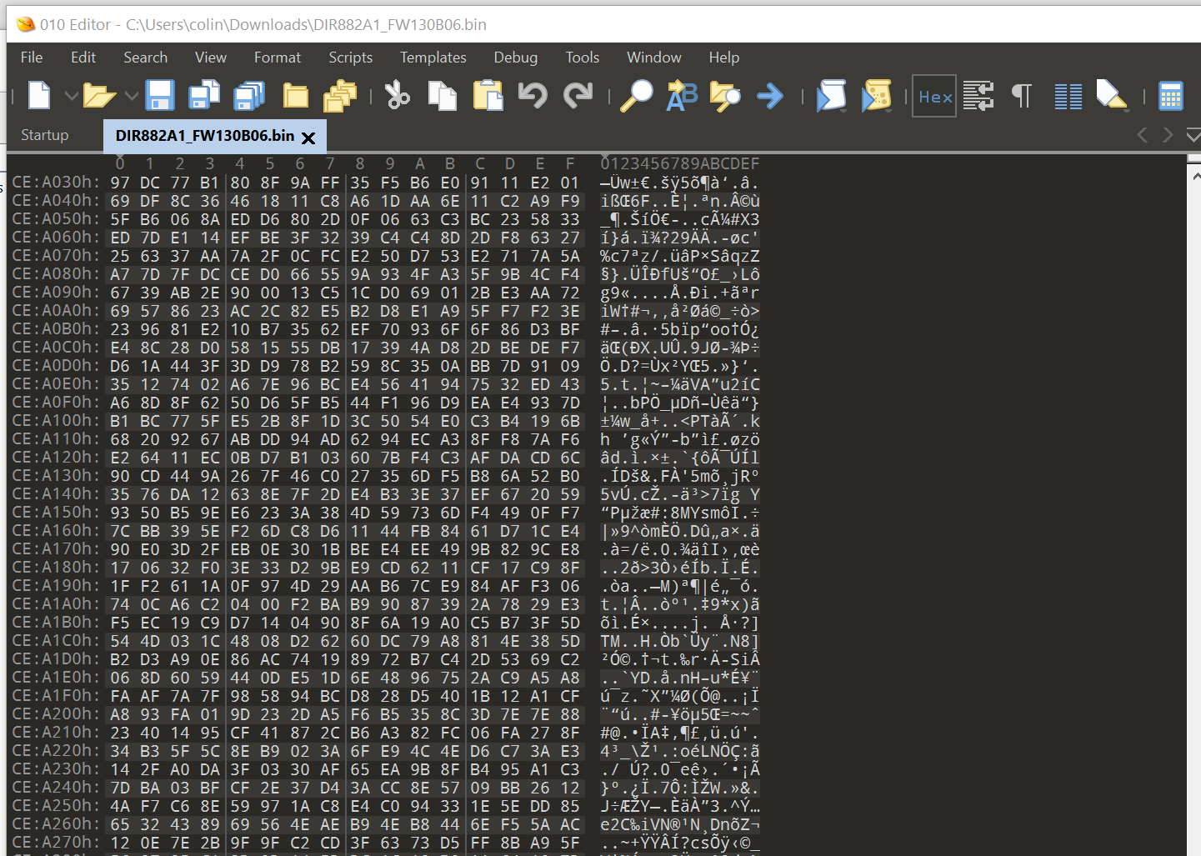
Viewing Binary (Unexciting Mode)
We use something called a hex editor to view raw files
See https://en.wikipedia.org/wiki/Comparison_of_hex_editors
E.g. – using https://www.sweetscape.com/010editor/ (other free ones out there)

Slide 6
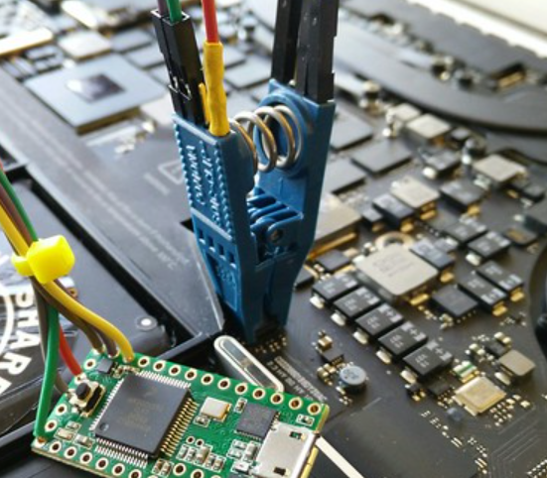
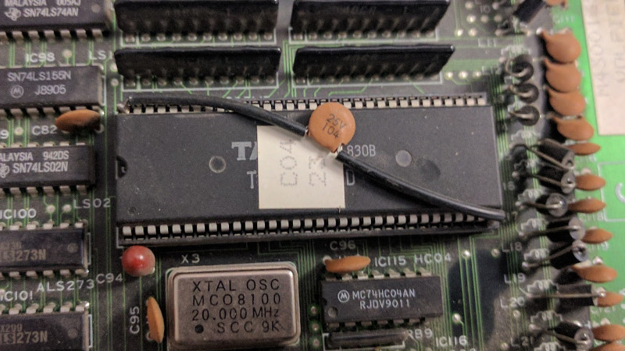
Where else to find Binaries?
Binaries can be extracted from systems, or dumped from memory.

Slide 7
Binary Exploration
Directly opening binaries isn’t too exciting normally.
Tools for exploring them exist – the most prominent is something called binwalker.
We can also open binaries that are executable in another tool (Ghidra) to understand the executable.

